Slide 1

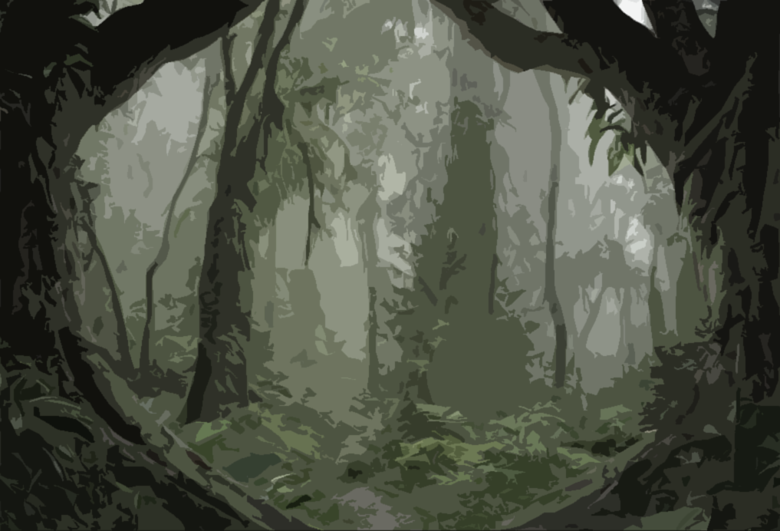
Tutorial
Hello and welcome to the CamoEvo tutorial. Here you will learn how to set up your own game, customise your population and play the game!
Use the mouse scroll, or arrow buttons to navigate.
Next Page

Slide 2
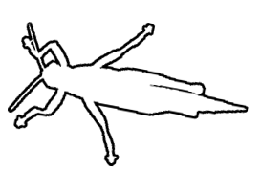
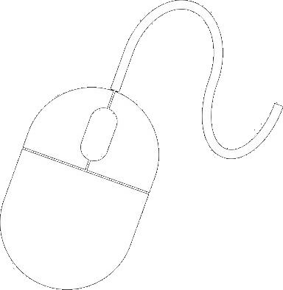
1) How to Play
If this is your first time playing. The aim of the game is to evolve a population of camouflaged ‘prey’ to habitats that you choose.
Get Photos Create a Population Then Play!
Prior Page
Next Page

Slide 3
2) Photos
You can obtain photos either by downloading them from online or by taking your own photos with a phone or camera.
Ideally photos should be from a….
birds eye view
cloudy day (less-shadows)
equal distance
Prior Page
Next Page

Slide 4
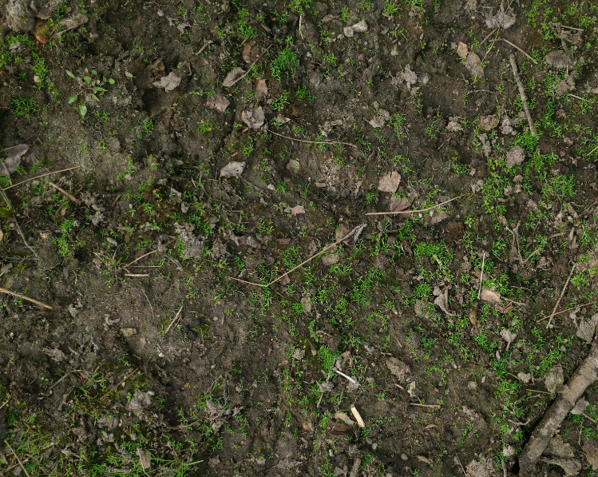
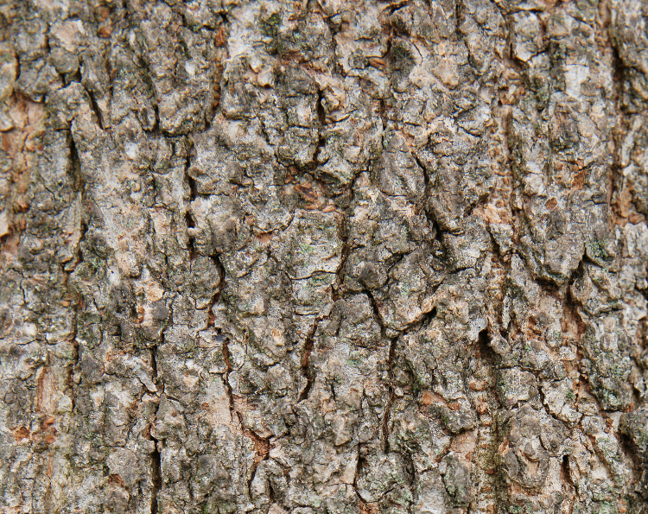
3) Example Photos
Toad Habitat
Moth Habitat
Prior Page
Next Page

Slide 5
4) Photo Upload
Once you’ve taken your photos or downloaded them you’ll want to store them in a folder that you know the location of and has no other files or photos in it.
Prior Page
Next Page

Slide 6
5) Starting the Game
Once you’ve taken your photos you will be able to create a population for your game. Load up CamoEvo and click New Game. Then follow the instructions.
Prior Page
Next Page

Slide 7
6) Loading a Game
If you have already created a game, you will be able to load it by clicking load game instead of new game. Then click on the file you want to load.
grassland
tundra
frogs
mothLand
empty
empty
empty
empty
Prior Page
Next Page

Slide 8
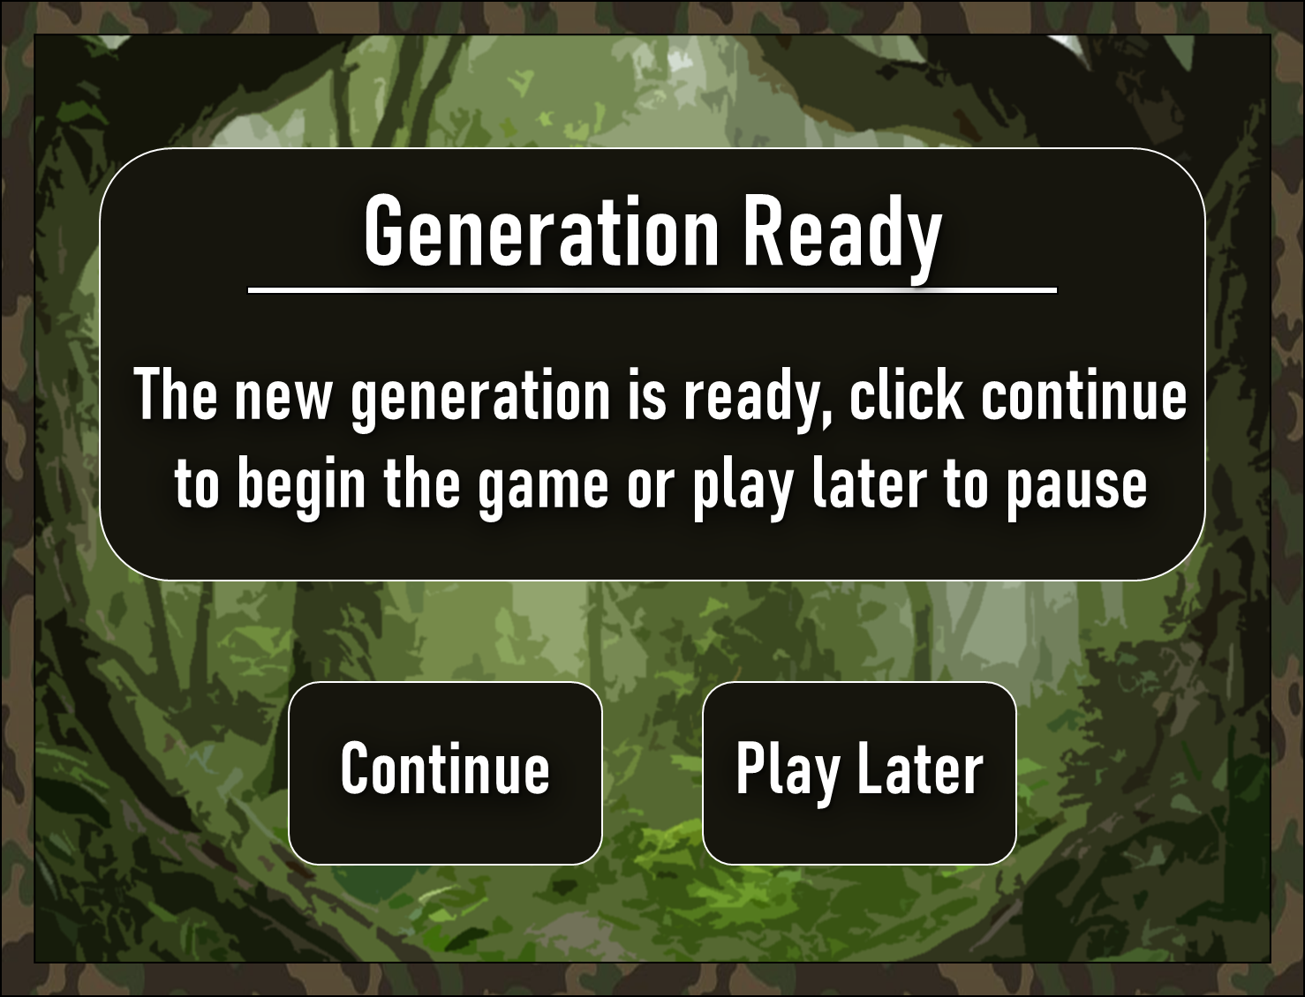
7) Playing the Game
Once you have created or loaded a game to play you will be presented with the following screen:
Prior Page
Next Page

Slide 9
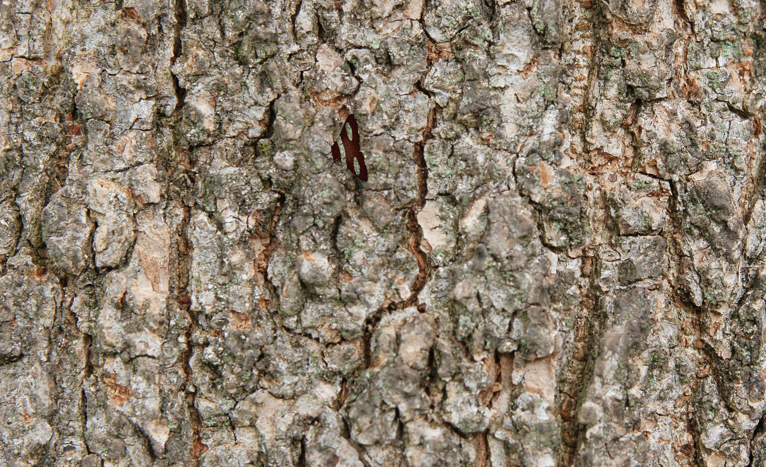
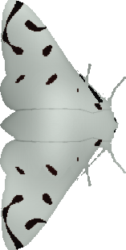
8) How to Play
Click Continue, your job will be to find and click on the targets as fast as you can!
Prior Page
Next Page

Slide 10
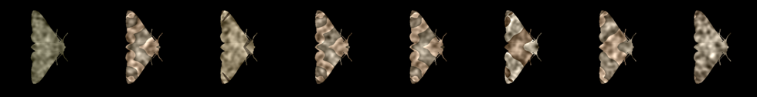
9) Evolution
Each time you play the game should get harder and harder as your populations evolve to camouflage under Natural Selection!
Prior Page
Next Page

Slide 11
10) Finish
Once you’ve played the game for all the generations you can either continue for 5 more generations, or view your results.
Click Here to
Return to Game

Slide 12
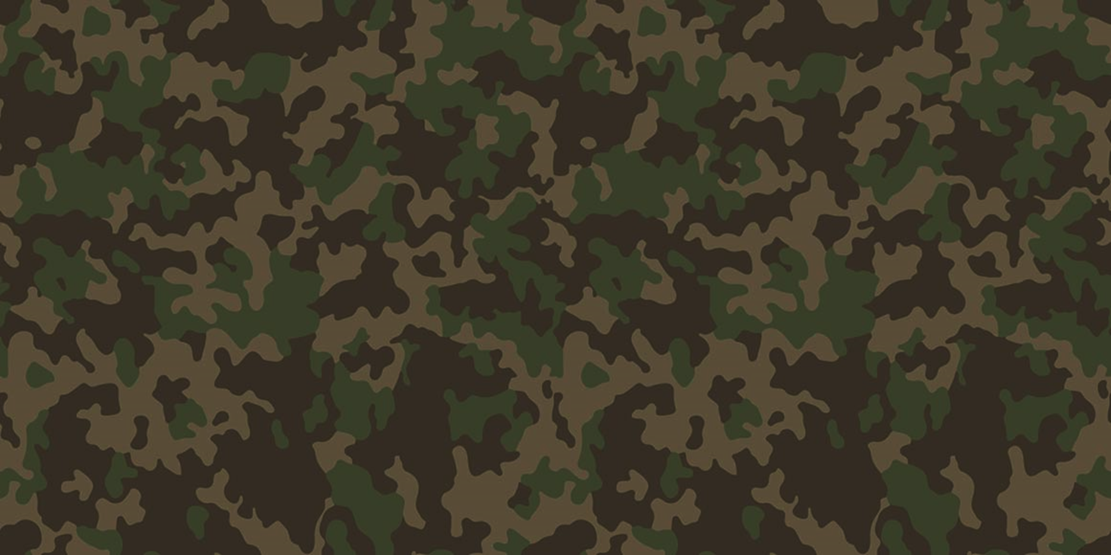
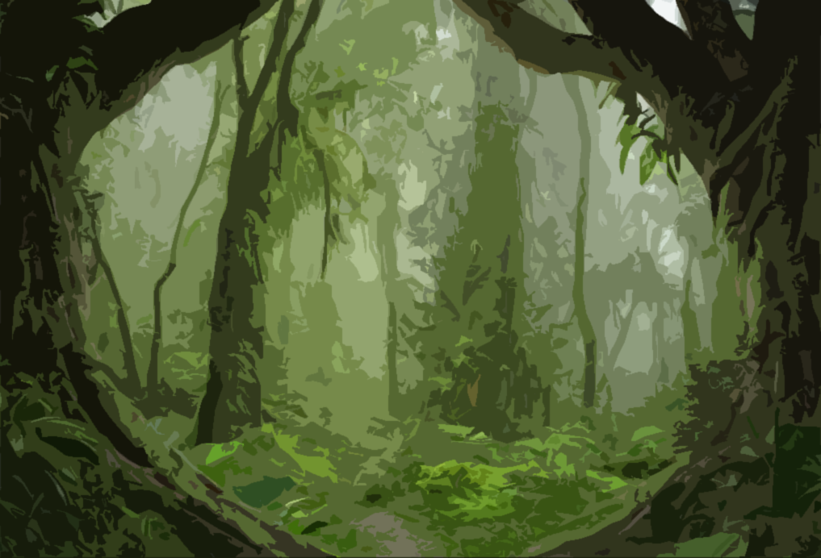
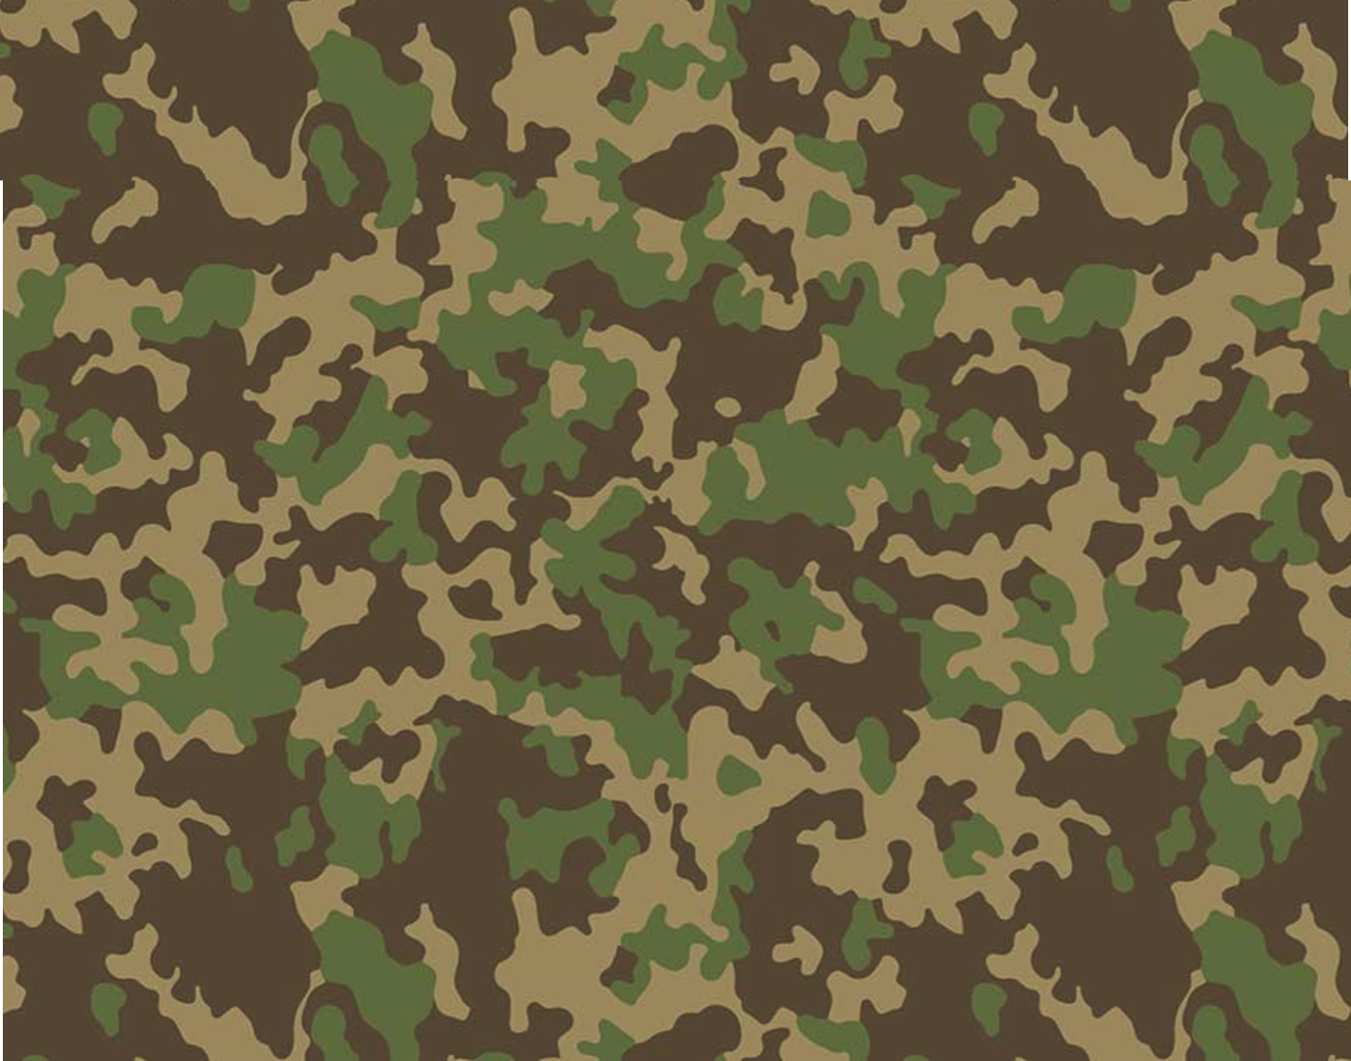
LOADING

Slide 13
LOADING.

Slide 14
LOADING..

Slide 15
LOADING…

Slide 16

Evolving Generation
Please do not exit.
Evolving

Slide 17
Evolving Generation
Please do not exit.
Evolving.

Slide 18
Evolving Generation
Please do not exit.
Evolving..

Slide 19
Evolving Generation
Please do not exit.
Evolving…

Slide 20


Photograph
Select
Evolve
Analyse
Tutorial
New Game
Load Game
Exit Game

Slide 21
Choose a Game
Choose a previous game by selecting a folder with the correct name.
Menu

Slide 22
Upload Photos
Select a folder containing photos you wish to use for your backgrounds.
(Do not click cancel!)
Get Photos
Menu

Slide 23



‘Science or Fun’
Do you wish to use more commonly used targets, animals, or your own custom shape?
Targets
Creator
Animals
Menu

Slide 24
Choose a Target
Click on which target shape you would like to try to find?
Triangle
Tear
Oval
Circle
Egg
Menu

Slide 25

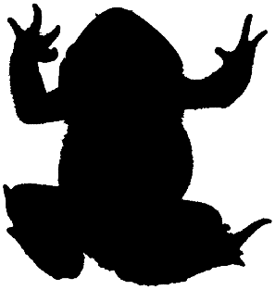
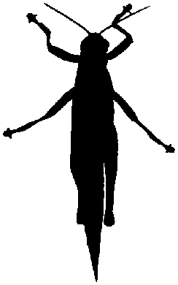
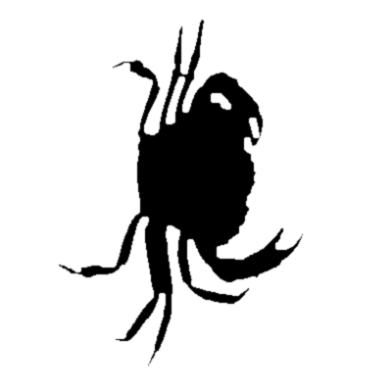
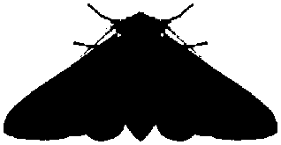
Choose an Animal
Click on which animal shape you would like to try to find?
Newt
Grasshopper
Toad
Crab
Moth
Menu

Slide 26

Target Creator
Import shape, choose a size and pattern then go.
Draw
Upload
Menu

Slide 27
Advanced Settings
Would you like to use advanced settings?
(Warning! some settings will make the game longer)
Yes
No
Menu

Slide 28
Generations
Choose how many generations you’d like to run. (More generations = longer games)
5
10
20
30
40
50
Menu

Slide 29
Choose a Pop Size
Choose how many individuals you’d like to use in a population. (More generations = longer games)
12
24
32
48
64
72
Menu

Slide 30
Group Size
Choose how many individuals can be presented on any one background. (Larger groups = shorter games)
1
2
3
4
6
Menu

Slide 31
Time Out Time
Choose how long you have to search for your targets. (Longer times = longer games).
10s
15s
20s
30s
45s
1 min
Menu

Slide 32
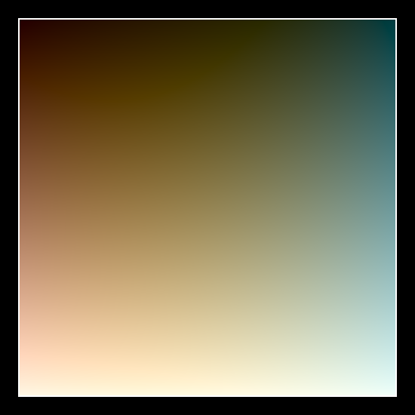
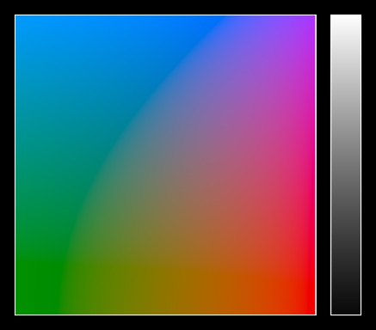
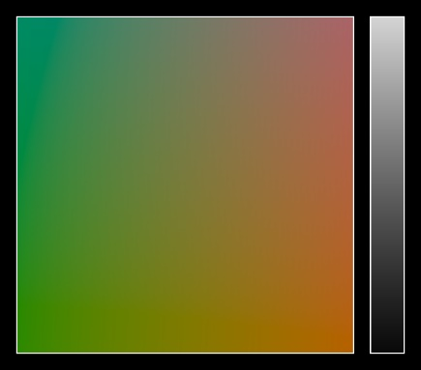
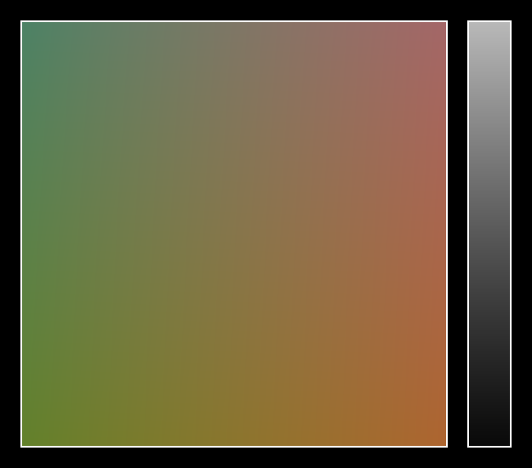
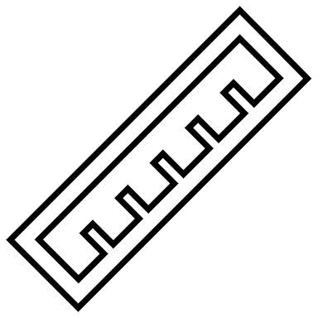

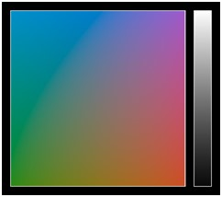
Starting Colours
Choose a colour range for the starting population.
(CIE LAB, Doesn’t include Eggs )
Full Space
Camo Space
Measure Space
Custom Space
Menu

Slide 33
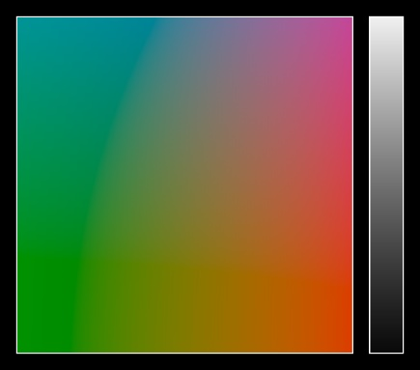
Exploration Space
Choose the colour bounds for CamoEvo.
(CIE LAB, Doesn’t include Eggs )
Full Space
Natural Space
Measure Space
Custom Space
Menu

Slide 34

Fitness Value
Choose a measure of fitness. (Longer or Shorter Detection)
Camouflage
Signalling
Fitness increases with capture time.
Fitness decreases with capture time.
Menu

Slide 35
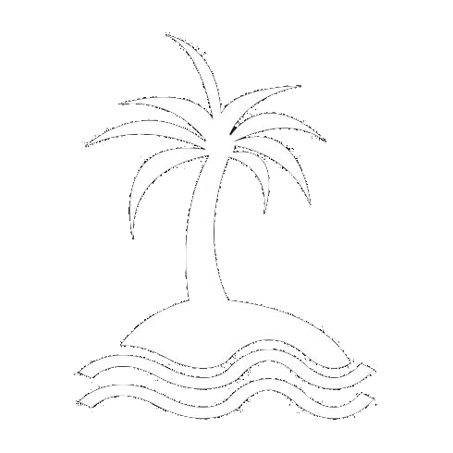
Name Population
Pick a Name for your Population. Note it can’t be any more than 15 characters.
Name
Menu

Slide 36
Generation Ready
The new generation is ready, click continue to begin the game or play later to pause.
Continue
Play Later

Slide 37
Import Shape

Slide 38
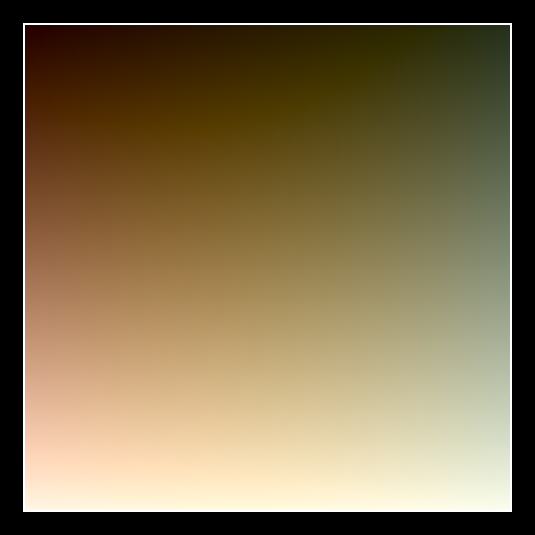
Starting Colours
Choose a colour range for the starting population.
(Eggs )
Full Space
Natural Space
Measure Space
Custom Space
Full Space
Camo Space
Menu

Slide 39
Exploration Space
Choose the colour bounds for CamoEvo.
(Eggs)
Full Space
Natural Space
Measure Space
Custom Space
Full Space
Camo Space
Menu

Slide 40
Game Complete!
You finished the game well done! Do you want to view your results or keep going?
Keep Going?
View Results

Slide 41
Game Complete!
You finished the game well done!
Analyse Camouflage
Keep Playing
Exit to Main Menu

Slide 42
Game Complete!
You finished the game well done!
Analyse Camo
Analyse Fitness
Evolution .gif
Keep Playing
Exit to Menu
Exit to Menu

Slide 43
Analysing
This may take a while…

Slide 44
Analysing.
This may take a while…

Slide 45
Analysing..
This may take a while…

Slide 46
Analysing…
This may take a while…

Slide 47
Analysis Complete!
Your results have been analysed.
Results Preview
Download Data
Exit to Main Menu

Slide 48
Fitness Stats
Top Targets
Basic Statistics.
Top 9 from last generation.
Camo Stats
Back to Menu

Slide 49
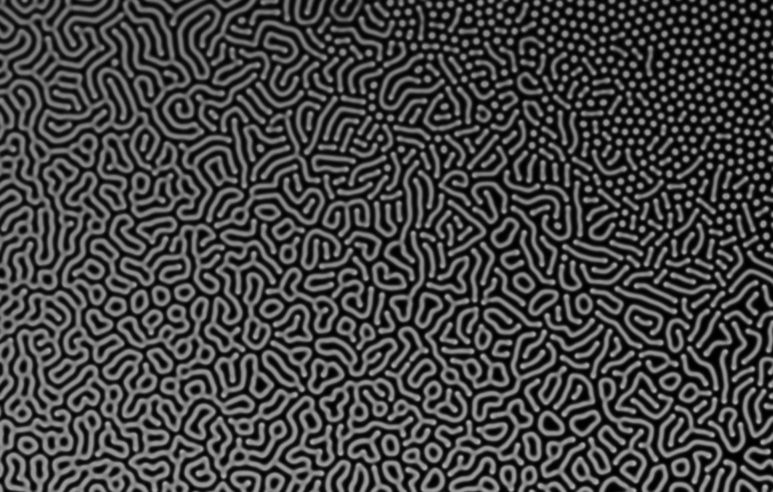
Camo Stats
Plot
Choose a statistic.
Luminance
Pattern
Colour
Disruption
Fitness Stats
Back to Menu

Slide 50
Wait a moment.
You haven’t downloaded your results!
Download & Exit
Exit

Slide 51
Analysis Complete!
Your results have been analysed.
Results Preview
Download Data
Exit to Main Menu

Slide 52
Capture Time
Top Targets
The measure of fitness.
Top 9 from last generation.
Menu
Camo

Slide 53
Camo Measures
Plot
Choose a statistic.
Luminance
Contast
Colour
Disruption
Fitness
Genes

Slide 54

Gene Variation Plot
Shows the range of values of the chosen gene for the first and last generation.
Choose a Gene
Camo
Menu

Slide 55
Wait a moment.
You haven’t downloaded your results!
Download & Exit
Exit

